Slide 1


WEEK 4
SPRINT 1
PL6
REQ

Slide 2


About Us.

Slide 3
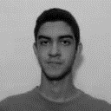
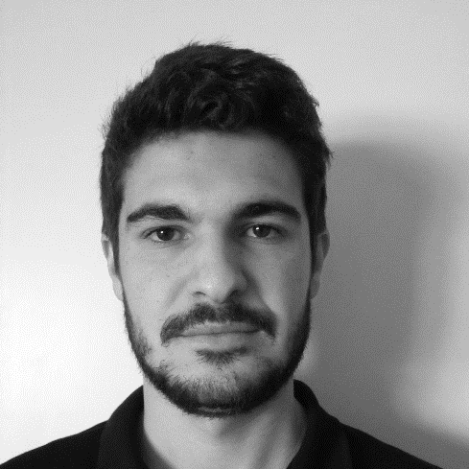
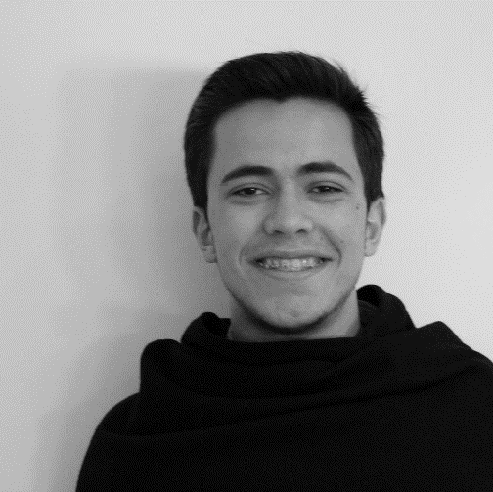
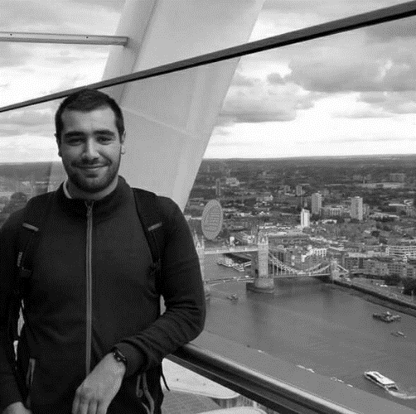
Req.
Alex
Emanuel
Marco
Paulo

Slide 4
Previous Tasks.
 | TASK #1 | TASK #2 | TASK #3 | TASK #4
TASK | Finish the mockups | Meeting with the client | Prepare the weekly presentation | Making of requirement document
OWNER | Alex/Emanuel/ Marco | Paulo, Emanuel | Paulo/Emanuel | Paulo
GOAL EFFORT | 4 H | 1 H | 1 H | 8 H
EFFECTIVE EFFORT | 4 H 35 | 0 H 55 | 1 H 10 | 6 H 45
STATUS | COMPLETED | Not completed | COMPLETED | COMPLETED

Slide 5
Previous Tasks.
 | TASK #5 | TASK #6 | TASK #7
TASK | Internal Meeting Minute | 1 Meeting with cliente Minute | 2 Meeting with cliente Minute
OWNER | Marco | Alex | Emanuel
GOAL EFFORT | 0 H 30 | 0 H 30 | 0 H 30
EFFECTIVE EFFORT | 0 H 45 | - | 0 H 20
STATUS | COMPLETED | NOT COMPLETED | COMPLETED

Slide 6
Planned Tasks.
 | TASK #1 | TASK #2 | TASK #3 | TASK #4
TASK | Meeting with the client | Update of the requirement document | Update the mockup | Internal meeting
OWNER | Team | Team | Team | Team
GOAL EFFORT | 1 H | 6 H | 6 H | 2h
STATUS | NEW TASK | IN PROGESS | IN PROGESS | NEW TASK

Slide 7
Additional Notes.

